Slide 1
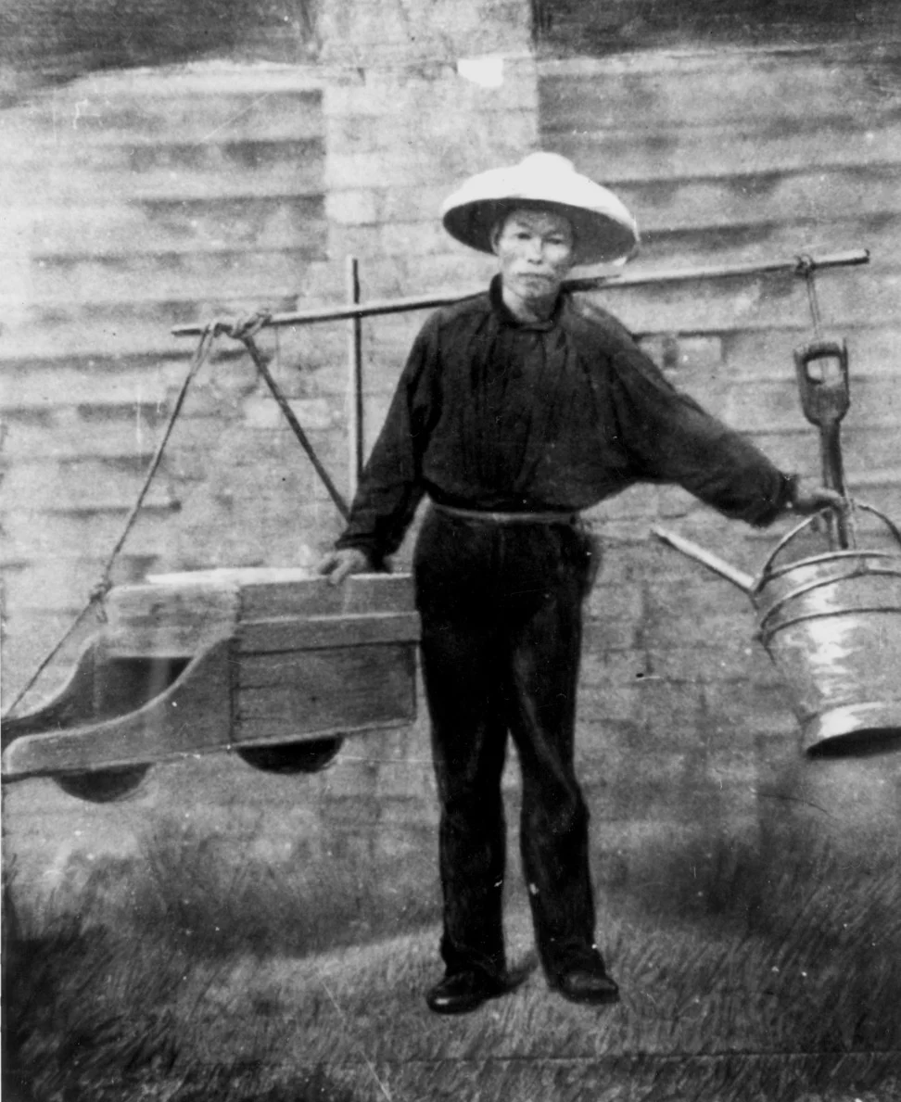
你好我的名字是望舒
我和我的家人住在广东
我是个農民
但是第一次鴉片戰爭以后
我没有钱养家里的孩子们
所以我希望在美国找到财富
Press P to continue
P.S rest of the game will be in English
Notes:
Image Source: https://www.google.com/url?sa=i&url=https%3A%2F%2Fwww.scmp.com%2Fmagazines%2Fpost-magazine%2Flong-reads%2Farticle%2F3051521%2Fchinese-immigrants-went-australia-looking-gold&psig=AOvVaw3ROGpNu8uXyF54Lhbkg25t&ust=1713578996936000&source=images&cd=vfe&opi=89978449&ved=0CBIQjRxqFwoTCLCxyK2ZzYUDFQAAAAAdAAAAABAE
Translation: Hello my name is WangSu. My family and I live in Guangdong. I’m a farmer, however after the first opium war(high taxes that came after the war ending), I don’t have enough money to support my family and children. So I hope I can find riches in America(California Gold Rush)
https://history.state.gov/milestones/1866-1898/chinese-immigration

Slide 2
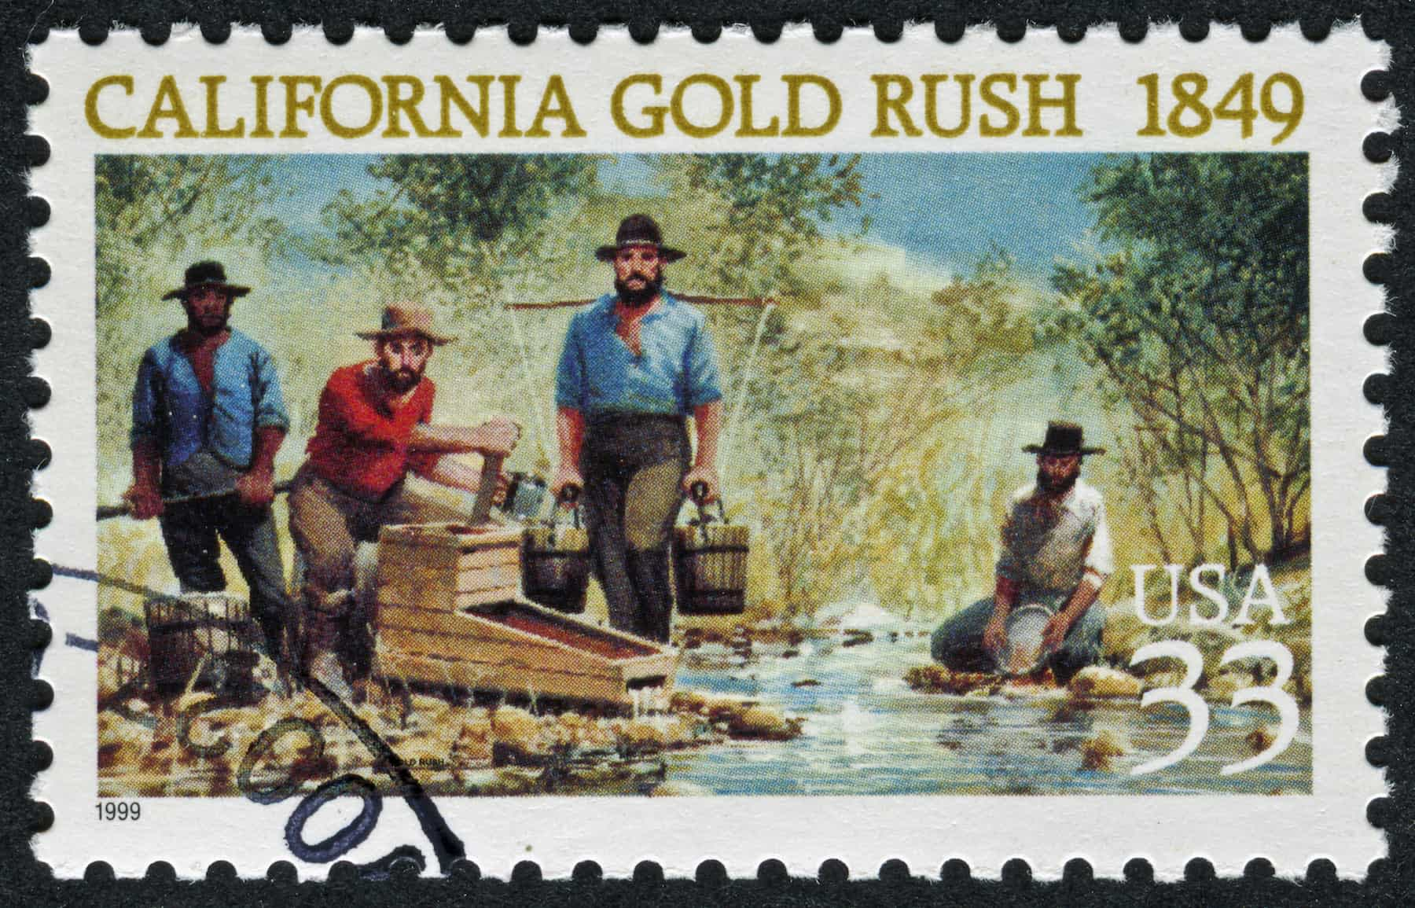
I must get to American, this Gold Mountain is my last resort!
Notes:
https://www.google.com/url?sa=i&url=https%3A%2F%2Fwww.flexport.com%2Fblog%2Ftrade-merchants-rich-california-gold-rush%2F&psig=AOvVaw1FHLj96OWr7LBGSDeiNsCB&ust=1713644093192000&source=images&cd=vfe&opi=89978449&ved=0CBIQjRxqFwoTCJColu-Lz4UDFQAAAAAdAAAAABBA
Many Chinese citizens in Guangdong learned about the california gold rush from merchant vessel
https://www.callutheran.edu/college-arts-sciences/history/civilliberties/chinese_civil_liberties_ver2.html#:~:text=With%20the%20railroad%20nearing%20completion,the%20most%20brutal%20years%20of

Slide 3

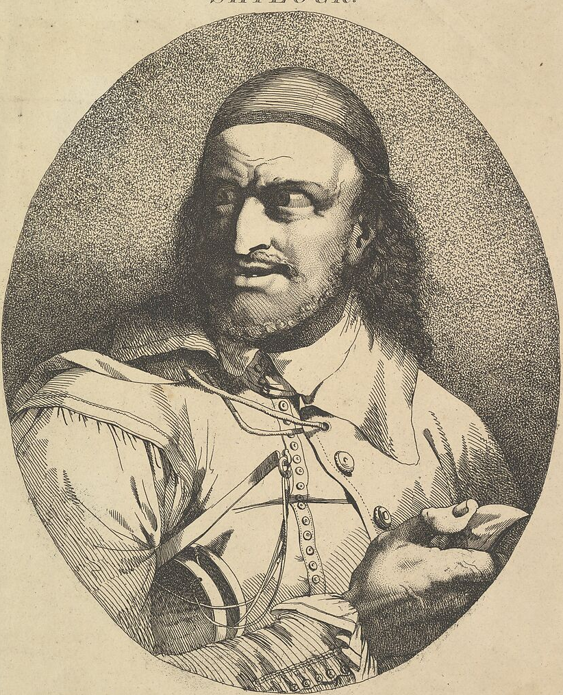
How Will I Get To America?
Your Choice
A or B
Travel to America through contract with Chinese Merchant
Travel to America through contract with British Merchant
Notes:
Chinese merchant Drawing source: https://www.google.com/url?sa=i&url=https%3A%2F%2Fwww.dreamstime.com%2Fillustration%2Fchinese-merchant.html&psig=AOvVaw2IThXA25vNtMlIOu-9a4vi&ust=1713643350907000&source=images&cd=vfe&opi=89978449&ved=0CBIQjRxqFwoTCOiQ7o2Jz4UDFQAAAAAdAAAAABAZ
British Merchant Drawing source:
https://www.google.com/url?sa=i&url=https%3A%2F%2Fwww.metmuseum.org%2Fart%2Fcollection%2Fsearch%2F400327&psig=AOvVaw3RIykNuYKB2ZTBwvV6-h1Z&ust=1713643682036000&source=images&cd=vfe&opi=89978449&ved=0CBIQjRxqFwoTCLiw36mKz4UDFQAAAAAdAAAAABAx
Merchants would help immigrants travel to America in exchange for a labor contract that made sure they would repay them https://www.sciencedirect.com/science/article/abs/pii/0014498387900039

Slide 4
You’ve reached California! It’s time to start making money.
Every day before the sun sets you need to make enough money by sifting for gold to pay back a portion of the travel fee as stated in the Contract you made with the Merchant. Otherwise the merchant will come for you!
At the end of every day living expenses and money sent back home to your family will be cut from you’re profits
If you don’t have any money after paying back the Merchant, you won’t be able to afford food and will become weak and starve
Since you’re a loving father the surplus money will always go to your family first before you spend any. If you end the day 3 times in a row without any money to send to your family they will starve to death.
Be careful of other unforeseen events that might affect you! Have fun and try to survive

Slide 5
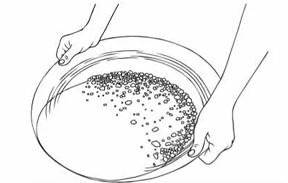
Press S to Keeping Sifting
Press N for new Batch to Sift through
Press E to end the day
Notes:
Panning Gold Image Source: https://www.google.com/url?sa=i&url=https%3A%2F%2Fwww.twinkl.com%2Fresource%2Fgold-panning-colouring-t-tp-2675734&psig=AOvVaw322qR89I_WEjMaF5EcdW3-&ust=1713643135159000&source=images&cd=vfe&opi=89978449&ved=0CBIQjRxqFwoTCODt96iIz4UDFQAAAAAdAAAAABAn
Prices for Gold Flakes:
https://www.parks.ca.gov/pages/22922/files/worksheet-goldrushprices.pdf

Slide 6
End of the Day Summary:
Notes:
Foreign Miner’s Tax(1850) Government taxed 20 dollars monthly
Prices for Gold Flakes Daily expected income and Cost of food
https://www.parks.ca.gov/pages/22922/files/worksheet-goldrushprices.pdf

Slide 7
I’LL KILL YOU IF YOU KEEP MISSING PAYMENTS

Slide 8

YOU GOT BEAT UP AND YOUR MONEY STOLEN AT NIGHT DUE TO RACIAL TENSION

Slide 9
You should be thankful that you owe me money! Otherwise you would of gotten beaten up tonight.

Slide 10
How this relates to what we have learned in class
The difficulty of the game rises as you get more money, as it takes a few months for you to build up money after paying back the money owed in your Contract. This is a representation of the growing hostility between whites and asian immigrants, as immigrants were viewed as people who were stealing their jobs. This lead up into a few problems where Asian immigrants were either found severely beaten up or even killed. This would also eventually lead to the passing of the Asian Exclusion Act, since tension got to an all time high, after America finished building the transcontinental railroad and the amount of job decreased. Also it’s important to note after the California Gold Rush many Chinese immigrants were pushed into cheap manual labor, which only caused more discourse. The early heavy taxation in the game is a reference to the Foreign Miners Tax passed in 1850 by California which heavily taxed immigrants and pushed many chinese immigrants to other types of unskilled labor. It was eventually repealed and the tax was set down to 4 dollars every month.
Notes:
https://blogs.loc.gov/inside_adams/2021/01/chinese-americans-gold-rush/

Slide 11
What Type of Sources I used
Sources for the information I found online were put into the speaker note of the respective slide where the information is referenced. Images were also sourced. Most of the information either came from .gov and .edu websites or from the Library of Congress. Each of the images on the slides are used in the game directly. Translations for the first slide are in speaker notes, didn’t write the entire game in chinese as my proficiency isn’t very high and I would rather not write an english and chinese version of the game.
Here is the link to the google slides. I had to make a powerpoint in order put the game and slides all into one folder. This will allow you to see the speaker notes
https://docs.google.com/presentation/d/1MHiwfIn3d899-OUV0iXl9TE3kqN4TT-strAf-cUA9J8/edit?usp=sharing

Slide 12
Sources
https://blogs.loc.gov/inside_adams/2021/01/chinese-americans-gold-rush/
https://www.sciencedirect.com/science/article/abs/pii/0014498387900039
https://www.parks.ca.gov/pages/22922/files/worksheet-goldrushprices.pdf
https://www.google.com/url?sa=i&url=https%3A%2F%2Fwww.scmp.com%2Fmagazines%2Fpost-magazine%2Flong-reads%2Farticle%2F3051521%2Fchinese-immigrants-went-australia-looking-gold&psig=AOvVaw3ROGpNu8uXyF54Lhbkg25t&ust=1713578996936000&source=images&cd=vfe&opi=89978449&ved=0CBIQjRxqFwoTCLCxyK2ZzYUDFQAAAAAdAAAAABAE
https://history.state.gov/milestones/1866-1898/chinese-immigration
https://www.callutheran.edu/college-arts-sciences/history/civilliberties/chinese_civil_liberties_ver2.html#:~:text=With%20the%20railroad%20nearing%20completion,the%20most%20brutal%20years%20of
https://www.google.com/url?sa=i&url=https%3A%2F%2Fwww.flexport.com%2Fblog%2Ftrade-merchants-rich-california-gold-rush%2F&psig=AOvVaw1FHLj96OWr7LBGSDeiNsCB&ust=1713644093192000&source=images&cd=vfe&opi=89978449&ved=0CBIQjRxqFwoTCJColu-Lz4UDFQAAAAAdAAAAABBA
https://www.google.com/url?sa=i&url=https%3A%2F%2Fwww.dreamstime.com%2Fillustration%2Fchinese-merchant.html&psig=AOvVaw2IThXA25vNtMlIOu-9a4vi&ust=1713643350907000&source=images&cd=vfe&opi=89978449&ved=0CBIQjRxqFwoTCOiQ7o2Jz4UDFQAAAAAdAAAAABAZ
https://www.google.com/url?sa=i&url=https%3A%2F%2Fwww.metmuseum.org%2Fart%2Fcollection%2Fsearch%2F400327&psig=AOvVaw3RIykNuYKB2ZTBwvV6-h1Z&ust=1713643682036000&source=images&cd=vfe&opi=89978449&ved=0CBIQjRxqFwoTCLiw36mKz4UDFQAAAAAdAAAAABAx

